Slide 1
Nonparametric Scene Parsing

Slide 2
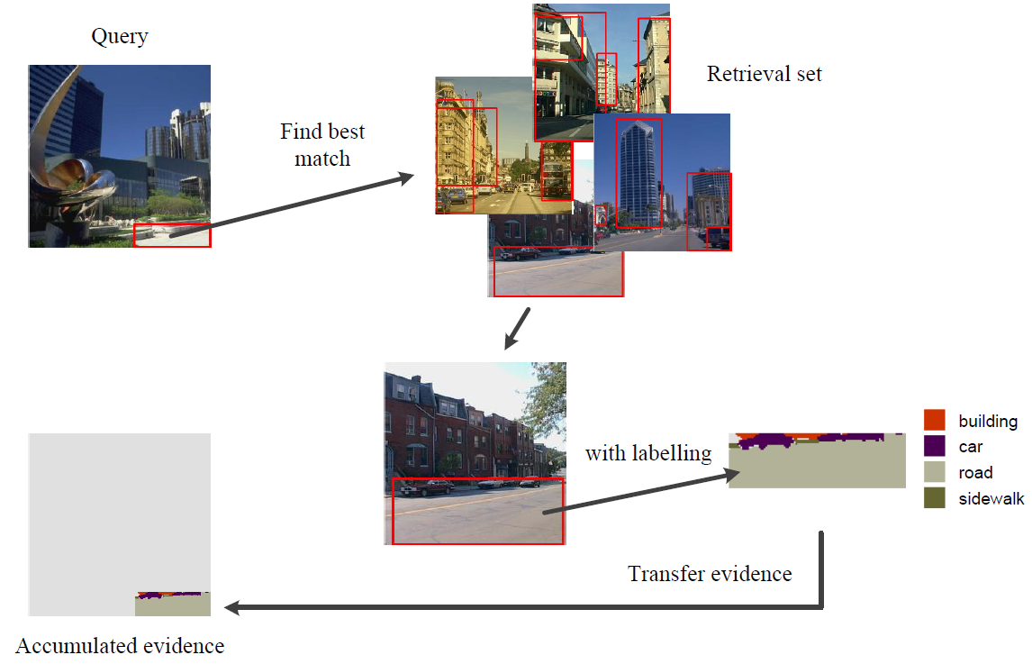
Windows based label transfer [TJ14]
F. Tung and J. J. Little. “CollageParsing: Nonparametric scene parsing by adaptive overlapping windows.” In ECCV, 2014.

Slide 3
Baseline System
Nonparametric scene parsing
Image retrieval
Image segmentation
Object window (instead of superpixels)
Label transfer
Window based label transfer
Align label to superpixel

Slide 4
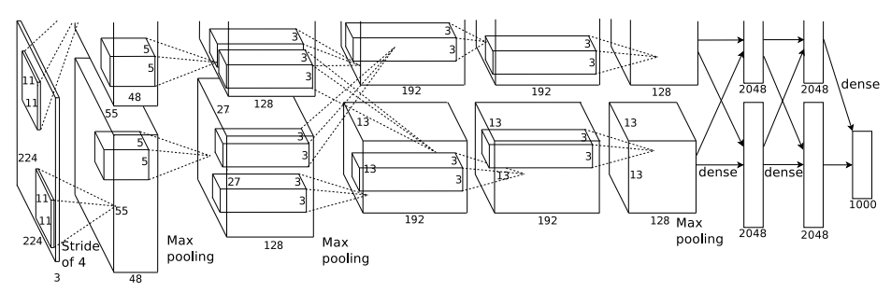
Image Retrieval
Retrieve similar image
Caffe CNN feature (7th layer) [KSH12]
Euclidean distance
Retrieve 400 images
7
A. Krizhevsky, I. Sutskever, and G. E. Hinton. ImageNet classification with deep convolutional neural networks. In NIPS, 2012.

Slide 5
Image Segmentation
R-CNN [GDDM14]
Region proposals / feature extraction
Selective search [USGS12]
Dilate 16 pixels
Resize to 227*227
Extract Caffe CNN feature
Ross Girshick, Jeff Donahue, Trevor Darrell and Jitendra Malik, “Rich feature hierarchies for accurate object detection and semantic segmentation,” CVPR, 2014.
J.R.R. Uijlings, K.E.A. Van de Sande, T.Gevers, and A.W.M. Smeulders, “Selective Search for Object Recognition,” IJCV, 2012

Slide 6

Label Transfer
Label Transfer
Four-connected pairwise MRF model
Alpha-beta swap algorithm [BVZ01]
Energy Function:
Adjacent pixels: p, q
Class : c
Unary energy
Label cost
Y. Boykov, O. Veksler, and R. Zabih. “Fast approximate energy minimization via graph cuts.” PAMI, 23(11):1222 – 1239, 2001.

Slide 7


Label Transfer
Energy function:
Unary energy
Label cost
Label co-occurrence statistics
Unary energy
Label cost
Window similarity
Give the penalty to
frequency of class

Slide 8
Align Labeling
Refine label region
To improve the alignment of the labelling
Superpixels in the query image share the same label
Assigned the most common label in the superpixels

Slide 9
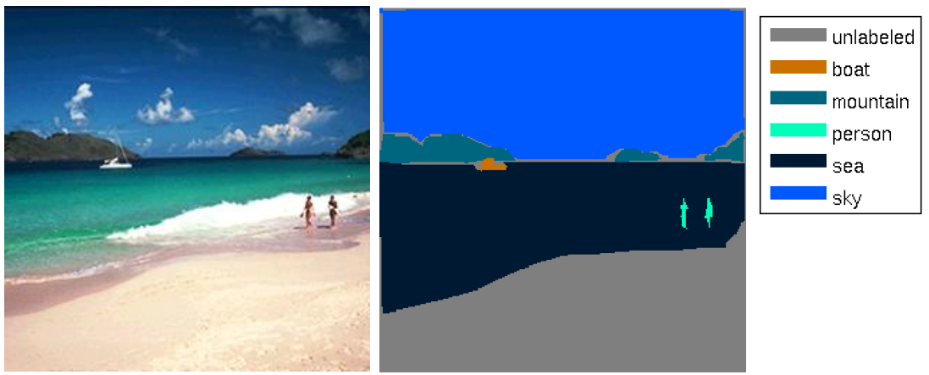

Dataset
SIFT Flow
200 testing images
2488 training images
33 classes
Image size 256$×$256

Slide 10
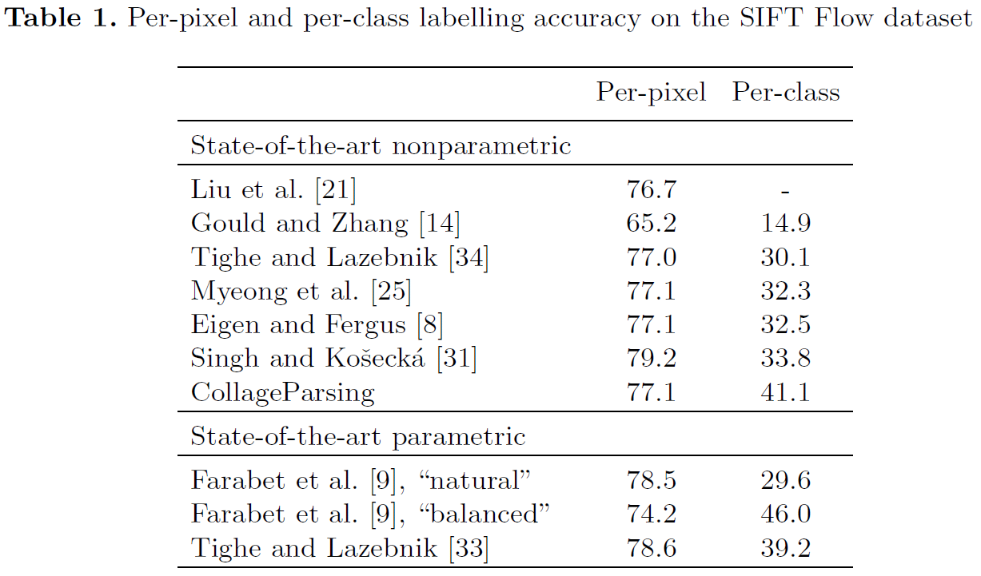
Experiments
[TL14] Sift Flow dataset
[TL14]
[YPCY14] (non-para) 79.8 48.7
J. Yang, B. Price, S. Cohen and M.Yang. Context driven scene parsing with attention to rare classes. In CVPR, 2014.
F. Tung and J. J. Little. CollageParsing: Nonparametric scene parsing by adaptive overlapping windows. In ECCV, 2014.
[33] J. Tighe and S. Lazebnik. Finding things: Image parsing with regions and per-exemplar detectors. In CVPR, 2013.

Slide 11
Results
 | per-pixel | per-class
State-of-the-art
baseline [YPCY14] | 78.0 | 27.5 | Superpixel based
full [YPCY14] | 79.8 | 48.7 | Rare class / semantic context
Collage Parsing [TJ14] | 77.1 | 41.1 | Window based
My results
superPixel based | 71.59 | 22.08
window based | 75.93 | 40.87 | K= 40/1
window based | 79.28 | 34.11 | K= 40/30
window based | 79.83 | 37.58 | K= 400/1 *
window based | 77.26 | 40.58 | K= 400/30
Only 1 time retrieval
J. Yang, B. Price, S. Cohen and M.Yang. “Context driven scene parsing with attention to rare classes.” In CVPR, 2014.
F. Tung and J. J. Little. “CollageParsing: Nonparametric scene parsing by adaptive overlapping windows.” In ECCV, 2014.

Slide 12
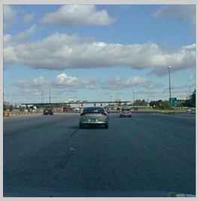
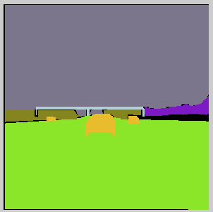
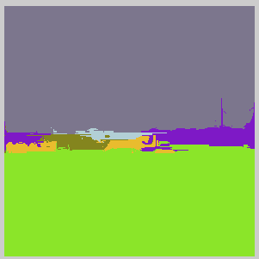

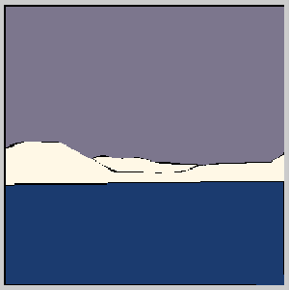

Reults

Slide 14
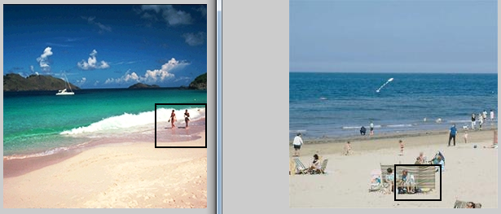
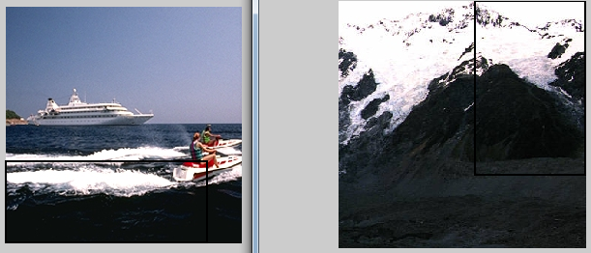
Problem
Object location/shape/size in the window
Window matching fail

Slide 15
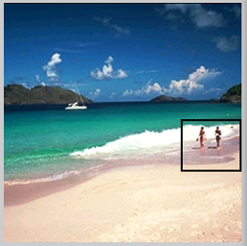
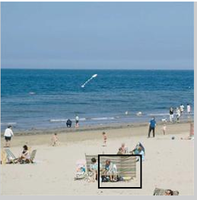
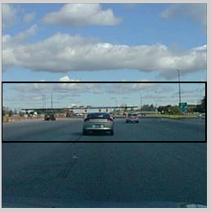
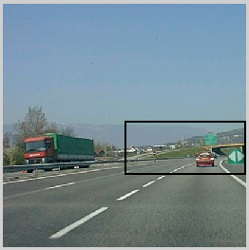
Object problem
Objects mismatch in the window pairs

Slide 16
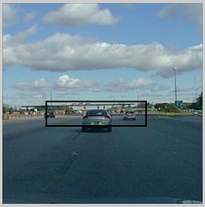
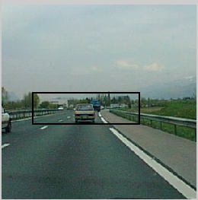
Solution 1
Proposal window size
Large window => background
Small window => small object class
Detect object
Small location error
Window size weight
Large window => small weight
Small window => large weight

Slide 17

Solution 1
MRF energy function:
Unary energy
Unary energy
Label cost
Window similarity
$$∅_{windowSize}(w)$$
Give the penalty to
frequency of class

Slide 18
Solution 2
Parse each proposal window

Slide 19
Solution 3
Co-saliency of proposal window

Slide 20

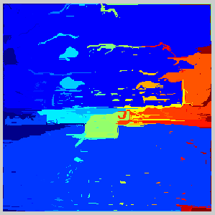
No size penalty

Slide 21
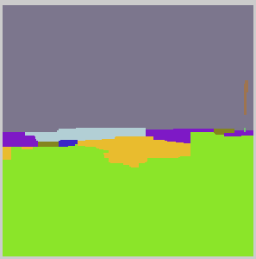
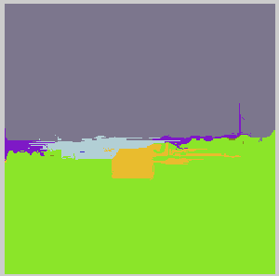
with size penalty

Slide 22
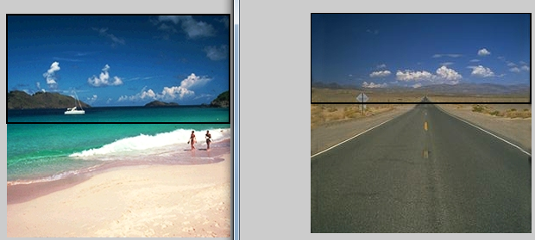
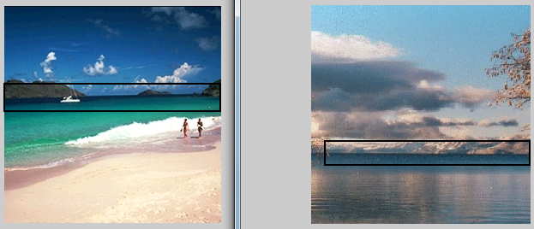

Slide 23
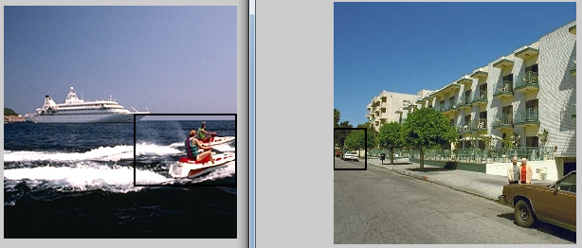

Slide 24
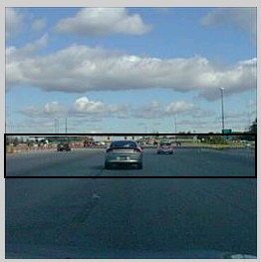
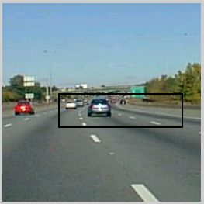

Slide 25
